Slide 1

Quiz Time
Notes:
Lets start with a quiz.
We are going to play the opposites game. I saw a word and you tell me the opposite.
We can do this as a whole class…just call out the opposite.
Hot (cold)
Up (down)
Fast (slow)
Success (most will say failure)

Slide 2
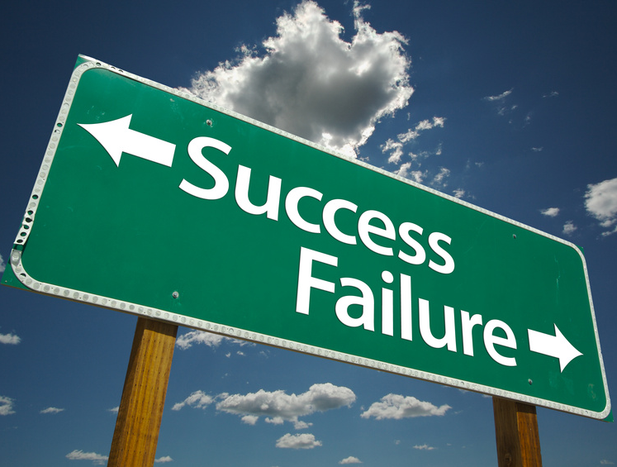
Notes:
Most of you said failure was the opposite of success. Well, what would you think if I said I don’t think that’s right?
I don’t think success and failure are opposites. In fact, I think they go together more than most of us think.
The way I think about it, failure isn't a bad thing.
In fact, sometimes failure about helps us with success.
Don’t believe me? Let me show you some interesting things.

Slide 3

When I fail at something…
When something becomes difficult…
Try Harder
Give Up
Notes:
We all have a choice when we fail at something…or when things get difficult…or when we are challenged.
We can either give up or we can work harder.
When times get tough, I want you all to know…that is when we need to work the hardest and not give up.
But you don’t need to take my word for it.
Let me share some stories with you.

Slide 4
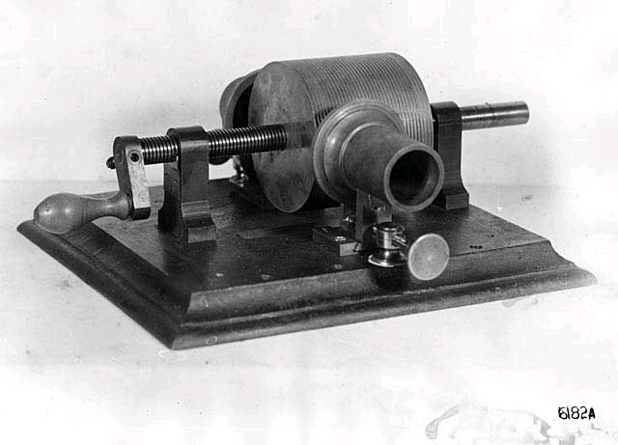
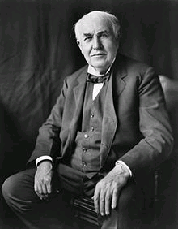

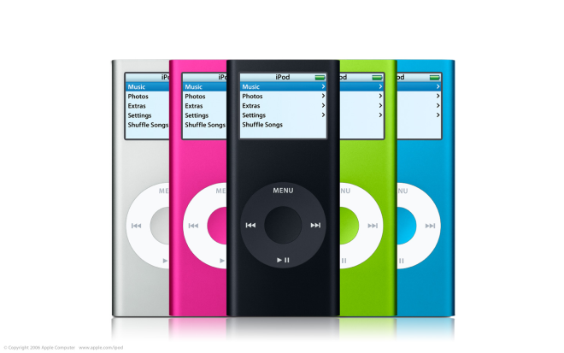
Thomas Edison
Notes:
This is Thomas Edison.
Famous inventor.
Because of him, we have things like MP3 players.
Here is something you may not know about Edison.
In 1914 his warehouse/lab had a horrible fire and burnt to the ground. The building was the home to all his research, his ideas, the projects he was working on….it had everything that he worked for in his life. And it caught fire and burnt down.
He was 67 at the time
Edison was quoted in The New York Times as saying, "Although I am over 67 years old, I'll start all over again tomorrow."
Estimated cost of the loss – 23 million in today’s money
He had a choice to make. Either give up or keep going.
What if he had given up? What if he had said…”Oh well, the fire destroyed everything and there is nothing I can do now.”?
3 weeks after the fire, he invented the first phonograph.
It was a machine that recorded sound.
Because of that invention….because he didn’t give up even though the fire was really bad and destroyed everything we now have things like Ipods.
But there is more.

Slide 5
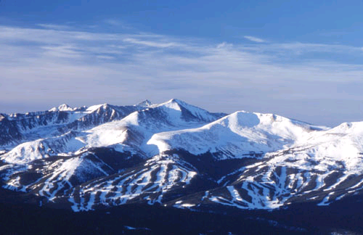
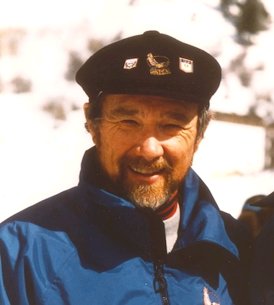
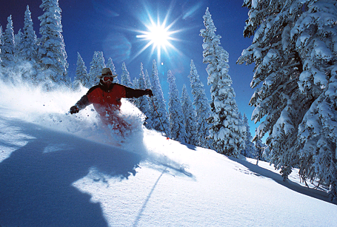
Notes:
This is a picture of a man named Pete Seibert.
He as a WWII veteran…that means he was a soldier in WWII.
He had a dream to open his own ski lodge. He loved to ski as a child in Europe so he thought it would be great if he could open a lodge and have people visit and ski during the winter.
He found the perfect place in a beautiful place in Colorado with lots of snow.
He thought he found the perfect place. So, he set out to build his lodge.
But lots of people told him he was crazy. The place he chose was too far away from big cities. No one would ever travel that far to go skiing. Besides, most Americans at the time didn’t ski.
Everyone he talked to told him why it wouldn’t work…it was too far away, not enough people ski, you don’t have enough money to advertise, there is no place to sleep, etc.
But he didn’t give up on his dream. Even though everyone was telling him to give up, he kept going after his dream.
Well, it took him many years, but he eventually was a success and opened his lodge in Vail, Colorado.
Most ski experts consider Vail to be one of the very best places on Earth to ski.
What if he had listed to everyone and given up?
But there’s more.

Slide 6
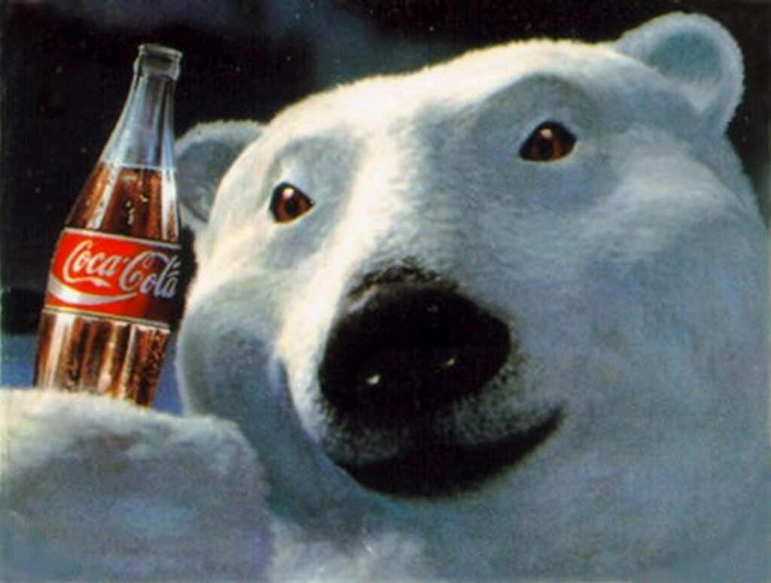

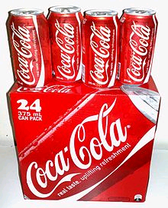
Notes:
We all know Coca-Cola, right?
Did you know that the very first year they made Coke they only sold 400 bottles?
What if they had given up?
But there’s more.

Slide 7
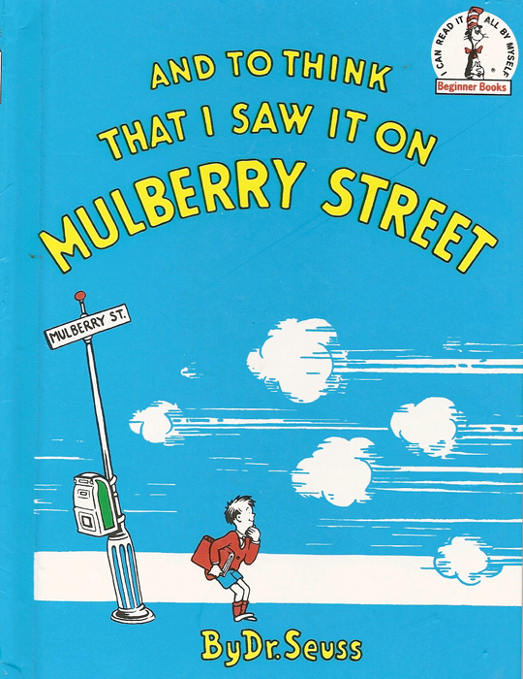
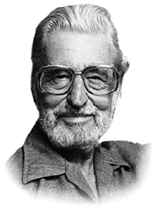
Notes:
We all love the stories of Dr. Seuss.
Well, before he was Dr. Seuss, he was Theodore Geisel.
This book, And to Think That I Saw It On Mulberry Street was his very first book.
Did you know that 27 different companies rejected his first book and didn’t want to print it?
He was told by 27 different companies that they didn’t think his book was good enough.
What if he had given up? After this book, he wrote some of our favorite books. Cat in the Hat, The Grinch, Green Eggs and Hat.
But there’s more.

Slide 8
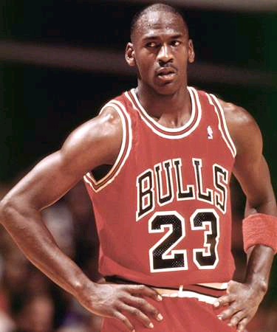
In high school, MJ didn’t make the varsity basketball team on his first try.
Notes:
Most of us know this guy…Michael Jordan.
He is widely considered to be the greatest (or one of the greatest) basketball players ever.
Did you know that when he first tried out he didn’t make his varsity high school basketball team?
What if he had given up?
But there’s more.

Slide 9
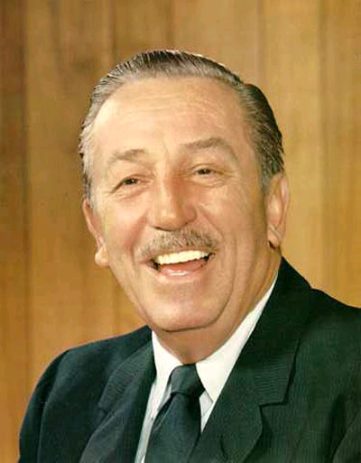
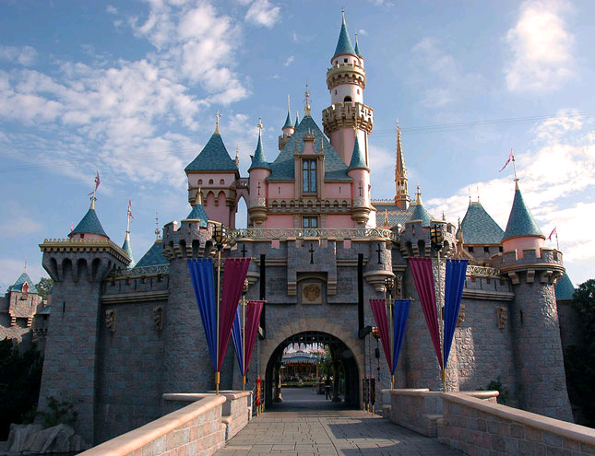
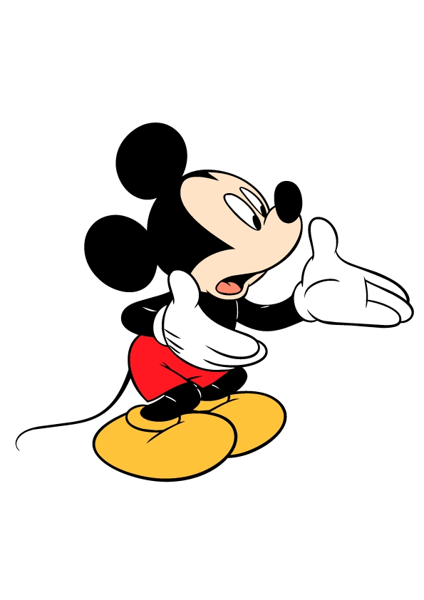
Notes:
This is Walt Disney.
Did you know that he was fired from a job and told he “lacked creative ideas”?

Slide 10
When I fail at something…
When something becomes difficult…
Try Harder
Give Up
Notes:
So, we all have a choice to make when things get difficult.
All of those people experienced failure or were told they couldn’t do what they wanted. But none of them gave up.
My hope and expectation for you is that you continue to work hard because sometimes things that seem like a failure are actually the first step to success.

